Slide 1

AUTOMATIC FEATURE EXTRACTION FROM BANK CHEQUES
K.T.L.Kalaivani (16IT041)
K.Meenadevi (16IT052)
R.Srividhya (16IT105)
DATE:20.09.2019
PROJECT GUIDE
Ms.K.V.Uma, Assisstant Professor

Slide 2
Overview
Introduction
Problem Statement & Descriptions
Objectives
Proposed Architecture
Work Flow Diagram
Modules with use cases
Implementation Environment Setup Knowledge
Application of Engineering Principles
State of the art to compare proposed idea
Social Relevancy & Impact on Environment
Individual Contributions
Action Plan
References

Slide 3
Introduction
Our project title is “AUTOMATIC FEATURE EXTRACTION FROM BANK CHEQUES”.
It is supposed to extract information from different data fields on the cheque such as amount, payee, date and signature.
After applying feature extraction, it can be used for payment processing.
This system can also be used for reading bank deposit slips, forms, data entry, postal address reading, script recognition etc.,

Slide 4
Problem Statement & Descriptions
Bank transactions involving cheques are still increasing throughout the world in spite of the overall usage of electronic payment methods.
Manual reading of bank cheque is really a time consuming task.
Our idea is to automatically extract the details from the scanned copy of bank cheques based on the image processing and feature extraction.

Slide 5
Objectives
From the scanned copy of bank cheque, the main objective is to obtain the most relevant information from the original data and represent the information in a lower dimensionality space using feature extraction.

Slide 6
Methodologies to solve the Problem- Proposed Architecture
Analysed the given data set and identified the static components present in the images.
Pre-processing is done to remove noise from the images.
Extracted particular region of interest based on the co-ordinate values or boundary values.
Detecting the characters and its numerals present in the particular region of interest and tried to extract its features.
Identified and extracted portion of image having data fields on the cheque such as amount, payee, date and signature and capture the details in to Excel or Csv file for further payment processing.

Slide 7
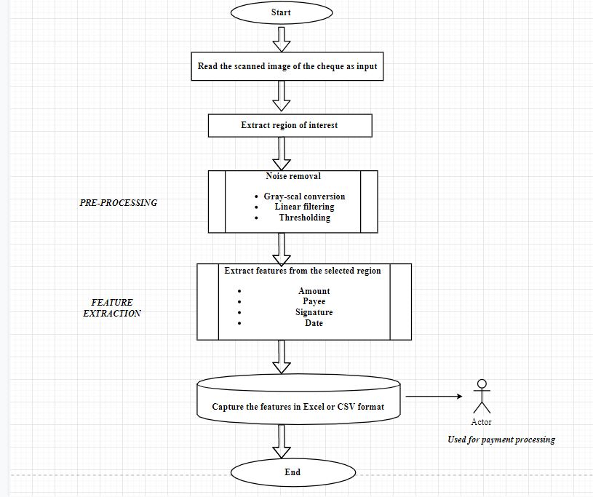
WORK FLOW DIAGRAM

Slide 8
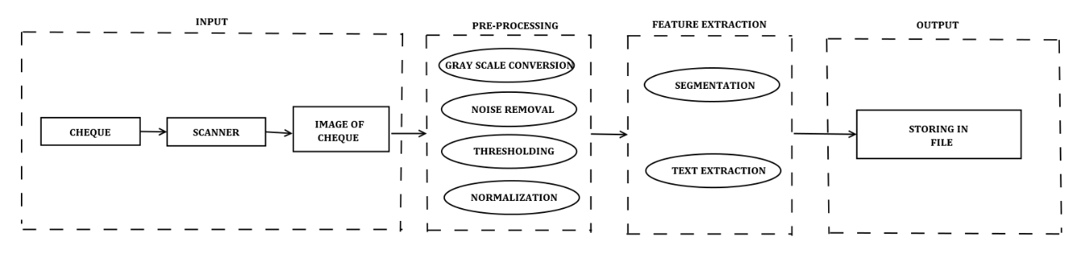
BLOCK DIAGRAM

Slide 9
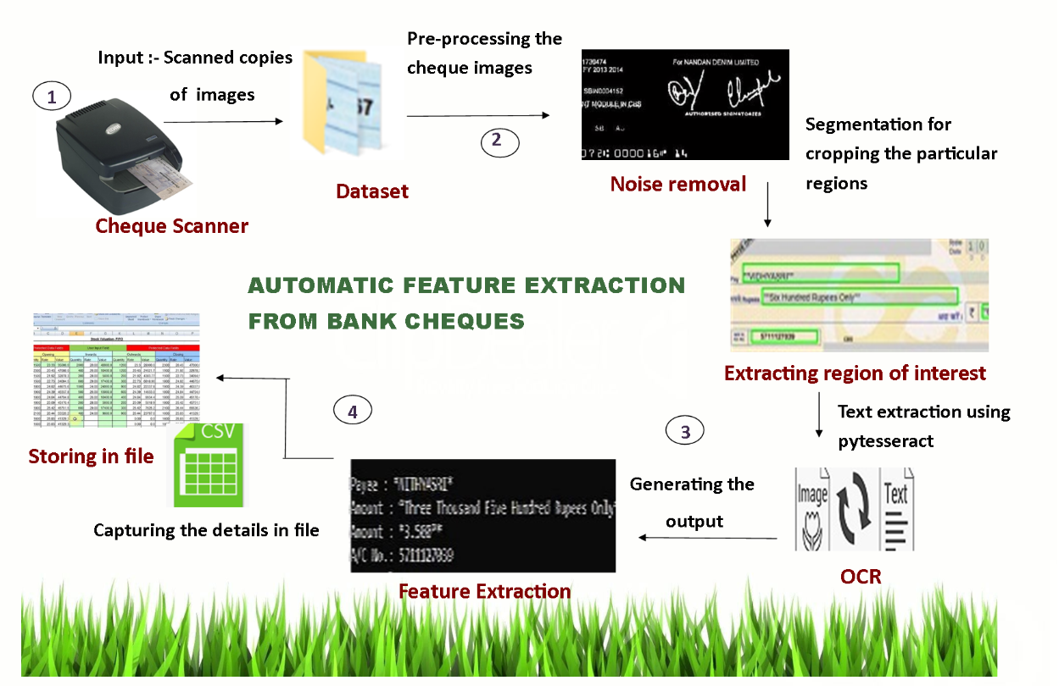
HIGH LEVEL DIAGRAM

Slide 10
Modules
Module 1 – Extracting the region of interest
Input – Bank cheque image
Output – Extracted image
Steps
Get the reference points (x-min, y-min, x-max, y-max)
With the reference points, a rectangle will be drawn around the region of interest.
Perform the cropping operation.
Save the cropped image.

Slide 11
Modules
Module 2 – Preprocessing
Input – Cropped image
Output – Image free of noise
Steps
Grayscale Conversion – Converting the cropped image into a grayscale image (RGB values = 24 bits to grayscale value = 8 bits).
Dilation – Used to highlight the features in the grayscale converted image.
Erosion – Erodes away the boundaries of foreground object.
Thresholding – Used to create binary image.

Slide 12
Modules
Module 3 – Feature Extraction
Input – Pre-processed image
Output – Details of cheque
Steps
Properties of the image – Finding the properties of image such as width, height, font size, colour of the cheque and RGB value.
Segmentation – Partitions an image into distinct regions containing each pixels with similar attributes.
Text extraction – Extracting the data such as amount, payee, date, signature.

Slide 13
Modules
Module 4 – Exporting the result
Input – Properties of image and text extracted from image
Output – Storing details in excel
Steps
Create a excel file initially.
Append the results at the end of spreadsheet each time while executing.
Save the results in the file.
Ensure that the file is not opened while executing the application.

Slide 14
Implementation Environment Setup Knowledge
Language – Python
Python works on different platforms (Windows, Mac, Linux, Raspberry Pi, etc).
Python runs on an interpreter system, meaning that code can be executed as soon as it is written. This means that prototyping can be very quick.
Python can be treated in a procedural way, an object-orientated way or a functional way.
A lot of general computer vision libraries are readily available for python.

Slide 15
Applications of Engg. Principles
Language – Python
Platform – Anaconda
Libraries used in python
Cv2 – OpenComputerVision library
PIL
Webcolours
Pytesseract
Tesseract-ocr
Openpyxl

Slide 16
Functions used in implementation
Function name Purpose
closest_colour - To find the rgb value of image
get_colour_name - To convert the rgb values to english colour name
get_string - To recognize the text from extracted image.
getDataColumn - To read the excel file
Writedata - To append the extracted feature values to excel file.
shape_selection - Extracting region of interest

Slide 17
State of art
“Correlation Based Template Matching For Recognition Of Bank Cheque Number”( Source – IEEE , Author – Raghavendra SP, Ajit Danti , Suresha M)
This system uses OCR for cheque number information extraction. Static images are taken and the characters in it are identified as a concentrated block. Based on matching process, the input block of characters and the existing samples are compared from the repository and the result is produced based on calculations. Major steps includes pre-processing the input image which states the input is valid or not and then identifying change in positions, standard size, considering many resolutions, physical changes, Zonal characters, Measuring distances, features related to ends and edges are highlighted. Once the acknowledgment phase starts , it uses usual methods of matching, using methods related to stats, obtaining the traces of images. In the next step, it uses scale-space feature extractor to remove unwanted gaps witnessed in input image extracted from the text obtained in the video. After that, the authenticated text is being compared with each of the text frame by frame. Since the characters are not of the expected format and especially in expected proportion. So as in this paper, it includes the entire cross verifications performed for such characters with the challenging task of Identification of Hand written characters in cheques. Thus the accuracy of the system with handwritten text is low as compared to the digital or printed characters

Slide 18
Social Relevancy & Impact on Environment
The processing and manual verification of bank cheques currently requires a large investment in human resource and it is also a time consuming task.
Its automation may achieve better performance and allow the reallocation of human resources to other tasks. Also, it saves the time of the bank employees.
Hence, this system has a positive impact in banking sector.

Slide 19
Action plan
Month | Week | Action Items (Week-wise)
July | Week 1 | Formation of team and chosen project title
July | Week 2 | Prepared abstract for the project
July | Week 3 | Literature review
July | Week 4 | Initiation of project idea implementation

Slide 20
Action Plan
Month | Week | Action Items (Week-wise)
August | Week 3 Week 4 | Chosen platform and software’s to be used for implementation Implementation of proposed architecture
September | Week 1 Week 2 Week 3 Week 4 Week 5 | Preparation for Review II Performance analysis and Optimization of code Performance analysis
October | Week 1 Week 2 Week 3 Week 4 Week 5 | Preparation for Review III Paper work Report writing

Slide 21
References
Xianlin Zhang , Xueming Li, Yang Liu, Fangxiang Feng (2019). A SURVEY ON FREE HAND SKETCH RECOGNITION AND RETRIEVAL. Retrieved from https://www.sciencedirect.com/science/article/pii/S0262885619300939
Raghavendra SP, Ajit Danti , Suresha M (JAN, 2019). CORRELATION BASED TEMPLATE MATCHING FOR RECOGNITION OF BANK CHEQUE NUMBER. Retrieved from http://www.ijcea.com/correlation-based-template-matching-recognition-bank-cheque-number/
R Jayadevan ,SR Kolhe, PM Patil ,U Pal (JUL, 2018). AUTOMATIC PROCESSING OF HANDWRITTEN BANK CHEQUE IMAGES . Retrieved from https://link.springer.com/article/10.1007/s10032-011-0170-8
Karthick Kanagarathinam, Kavaskar Sekar (2019). TEXT DETECTION AND RECOGNITION IN RAW IMAGE DATASET OF SEVEN SEGMENT DIGITAL ENERGY METER DISPLAY. Retrieved from https://www.sciencedirect.com/science/article/pii/S0167739X18322180

Slide 22
References
L. Minh Dang, Syed Ibrahim Hassan, Suhyeon Im, Irfan Mehmood, Hyeonjoon Moon (2018). TEXT RECOGNITION FOR THE DEFECTS EXTRACTION IN SEWERS CCTV INSPECTION VIDEOS. Retrieved fromhttps://www.sciencedirect.com/science/article/abs/pii/S0166361517304633
Leena Mary Francis , N. Sreenath (2019). DETECTION OF TEXT IN THE NATURAL ENVIRONMENT. Retrieved from https://www.sciencedirect.com/science/article/pii/S0167739X18322180

Slide 23
THANK YOU

